Slide 1
Chapter 1: Introduction
西电学堂 xt.xidian.edu.cn 搜索“数据库”

Slide 2
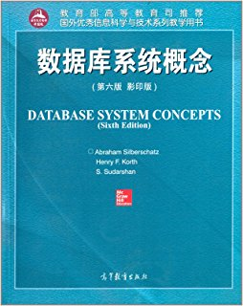
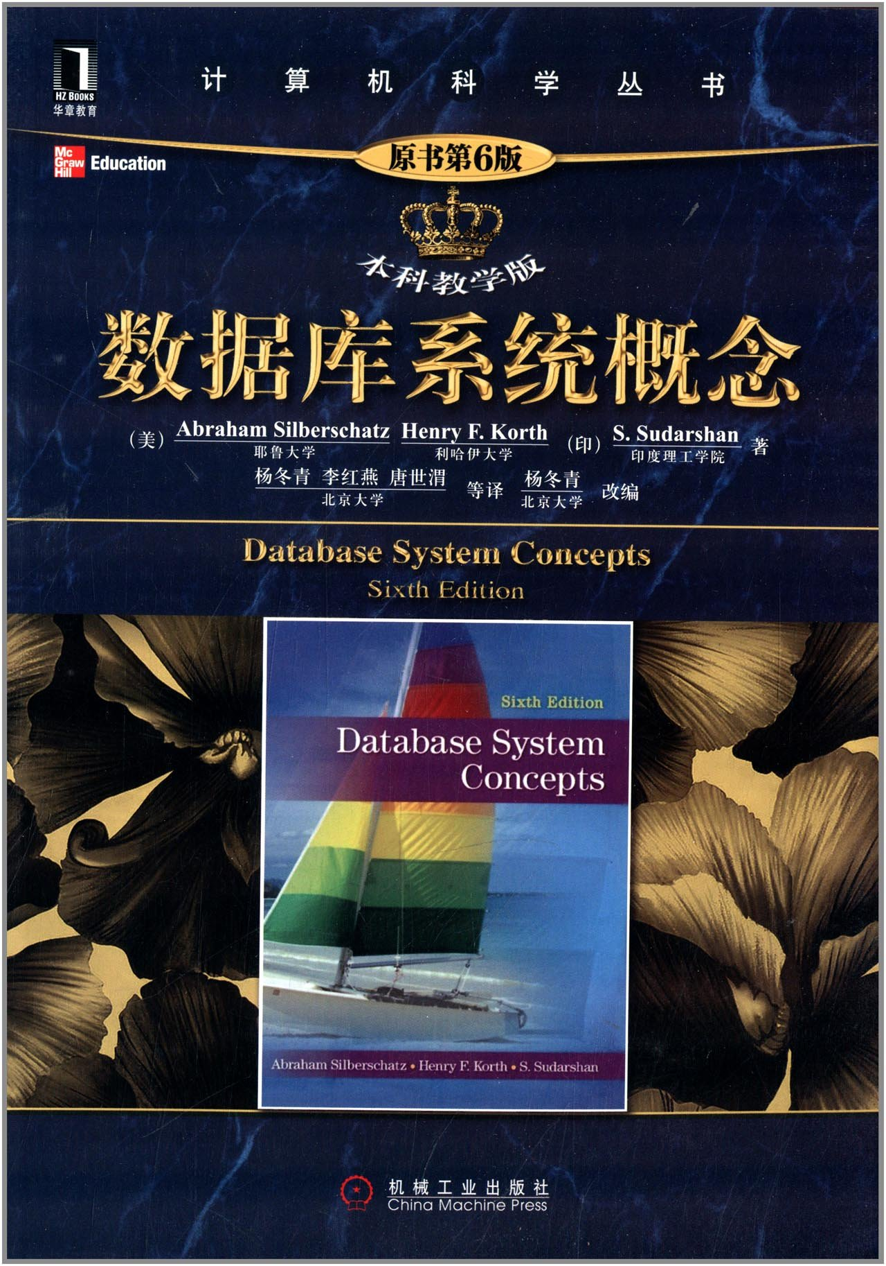
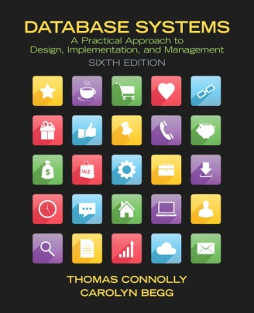

Book
  Abraham Silberschatz, Henry F. Korth, S.Sudarshan, Database System Concepts (6th ed.), The McGraw-Hill Companies, 2011
Reference Books
  Thomas M. Connolly, et al. Database Systems: A practical approach to Design, Implementation, and Management. 6th edition, Addison-Wesley, 2014
  王珊，萨师煊《数据库系统概论》 高等教育出版社(第5版),2014

Slide 3
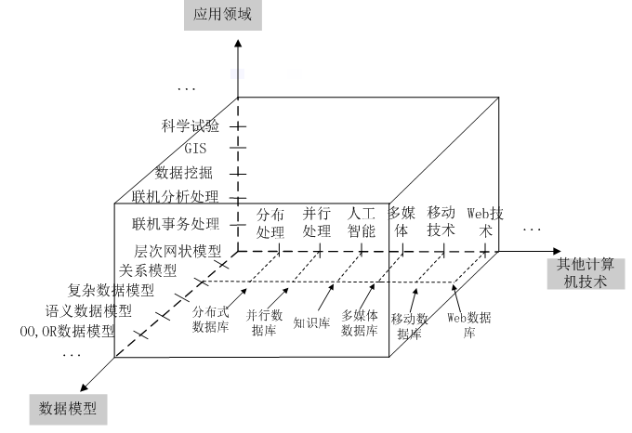

Slide 4
Outline
The Need for Databases
Data Models
Relational Databases
Database Design
Storage Manager
Query Processing
Transaction Manager

Slide 5
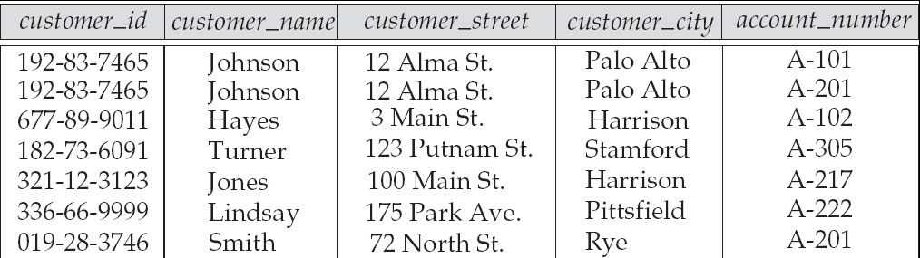
Data & Database
How to management Information (Data)?
    data: data are raw facts that describe people, objects, and events.

Slide 6
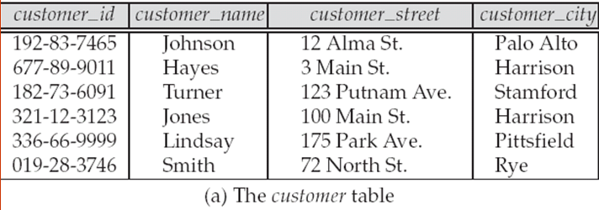
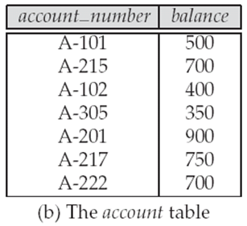
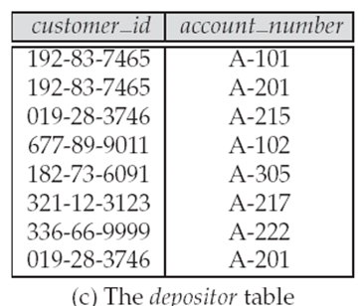
Data & Database
How to management Information(Data)?
    Database : An integrated collection of related data constitutes a Database (DB).

Slide 7
Database Management System (DBMS)
DBMS contains information about a particular enterprise
  Collection of interrelated data
  Set of programs to access the data
  An environment that is both convenient and efficient to use
Database Applications:
  Banking: transactions
  Airlines: reservations, schedules
  Universities: registration, grades
  Sales: customers, products, purchases
  Online retailers: order tracking, customized recommendations
  Manufacturing: production, inventory, orders, supply chain
  Human resources: employee records, salaries, tax deductions
Databases can be very large.
Databases touch all aspects of our lives

Slide 8
University Database Example
Application program examples
  Add new students, instructors, and courses
  Register students for courses, and generate class rosters
  Assign grades to students, compute grade point averages (GPA) and generate transcripts
In the early days, database applications were built directly on top of file systems

Slide 9
Drawbacks of using file systems to store data
Data redundancy and inconsistency
  Multiple file formats, duplication of information in different files
Difficulty in accessing data
  Need to write a new program to carry out each new task
Data isolation
  Multiple files and formats
Integrity problems
  Integrity constraints (e.g., account balance > 0) become “buried” in program code rather than being stated explicitly
  Hard to add new constraints or change existing ones

Slide 10
Drawbacks of using file systems to store data (Cont.)
Atomicity of updates
  Failures may leave database in an inconsistent state with partial updates carried out
  Example: Transfer of funds from one account to another should either complete or not happen at all
Concurrent access by multiple users
  Concurrent access needed for performance
  Uncontrolled concurrent accesses can lead to inconsistencies
    Example: Two people reading a balance (say 100) and updating it by withdrawing money (say 50 each) at the same time
Security problems
  Hard to provide user access to some, but not all, data
Database systems offer solutions to all the above problems

Slide 11
Levels of Abstraction
Physical level: describes how a record (e.g., instructor) is stored.
Logical level: describes data stored in database, and the relationships among the data.
  type instructor = record
  ID : string;
  name : string;
  dept_name : string;
  salary : integer;
        end;
View level: application programs hide details of data types. Views can also hide information (such as an employee’s salary) for security purposes.

Slide 12

View of Data
An architecture for a database system

Slide 13
DBMS Architecture
成绩单
学号：xxxxx | 姓名：xxx | 性别：x
离散数据 |  | 75
数据库系统 |  | 81
…… |  | ……
外模式（External Schema，也称子模式或用户模式）
——数据库用户使用的局部数据的逻辑结构和特征的描述
模式（Logical Schema, Schema，也称逻辑模式）
——数据库中全体数据的逻辑结构和特征（型）的描述
Sno | Sname | Ssex | Sage | Sdept
Cno | Cname | Cpno | Ccredit
Sno | Cno | Grade
内模式（Physical Schema，也称存储模式）
——数据物理结构和存储方式的描述

Slide 14
Instances and Schemas
Similar to types and variables in programming languages
Logical Schema – the overall logical structure of the database
  Example: The database consists of information about a set of customers and accounts in a bank and the relationship between them
    Analogous to type information of a variable in a program
Physical schema– the overall physical structure of the database
Instance – the actual content of the database at a particular point in time
  Analogous to the value of a variable
Physical Data Independence – the ability to modify the physical schema without changing the logical schema
  Applications depend on the logical schema
  In general, the interfaces between the various levels and components should be well defined so that changes in some parts do not seriously influence others.

Slide 15
Data Models
A collection of tools for describing
  Data
  Data relationships
  Data semantics
  Data constraints
Relational model
Entity-Relationship data model (mainly for database design)
Object-based data models (Object-oriented and Object-relational)
Semistructured data model (XML)
Other older models:
  Network model
  Hierarchical model

Slide 16

Relational Model
All the data is stored in various tables.
Example of tabular data in the relational model
Columns
Rows

Slide 17
A Sample Relational Database

Slide 18
Data Definition Language (DDL)
Specification notation for defining the database schema
  Example: create table instructor (
  ID char(5),
  name varchar(20),
  dept_name varchar(20),
  salary numeric(8,2))
DDL compiler generates a set of table templates stored in a data dictionary
Data dictionary contains metadata (i.e., data about data)
  Database schema
  Integrity constraints
    Primary key (ID uniquely identifies instructors)
  Authorization
    Who can access what

Slide 19
Data Manipulation Language (DML)
Language for accessing and manipulating the data organized by the appropriate data model
  DML also known as query language
Two classes of languages
  Pure – used for proving properties about computational power and for optimization
    Relational Algebra
    Tuple relational calculus
    Domain relational calculus
  Commercial – used in commercial systems
    SQL is the most widely used commercial language

Slide 20
SQL
The most widely used commercial language
SQL is NOT a Turing machine equivalent language
To be able to compute complex functions SQL is usually embedded in some higher-level language
Application programs generally access databases through one of
  Language extensions to allow embedded SQL
  Application program interface (e.g., ODBC/JDBC) which allow SQL queries to be sent to a database

Slide 21
Database Design
The process of designing the general structure of the database:
Logical Design – Deciding on the database schema. Database design requires that we find a “good” collection of relation schemas.
  Business decision – What attributes should we record in the database?
  Computer Science decision – What relation schemas should we have and how should the attributes be distributed among the various relation schemas?
Physical Design – Deciding on the physical layout of the database

Slide 22

Database Design (Cont.)
Is there any problem with this relation?

Slide 23
Design Approaches
Need to come up with a methodology to ensure that each of the relations in the database is “good”
Two ways of doing so:
  Entity Relationship Model (Chapter 7)
    Models an enterprise as a collection of entities and relationships
    Represented diagrammatically by an entity-relationship diagram:
  Normalization Theory (Chapter 8)
    Formalize what designs are bad, and test for them

Slide 24
Database Engine
Storage manager
Query processing
Transaction manager

Slide 25
Storage Management
Storage manager is a program module that provides the interface between the low-level data stored in the database and the application programs and queries submitted to the system.
The storage manager is responsible to the following tasks:
  Interaction with the OS file manager
  Efficient storing, retrieving and updating of data
Issues:
  Storage access
  File organization
  Indexing and hashing

Slide 26

Query Processing
1. Parsing and translation
2. Optimization
3. Evaluation

Slide 27
Query Processing (Cont.)
Alternative ways of evaluating a given query
  Equivalent expressions
  Different algorithms for each operation
Cost difference between a good and a bad way of evaluating a query can be enormous
Need to estimate the cost of operations
  Depends critically on statistical information about relations which the database must maintain
  Need to estimate statistics for intermediate results to compute cost of complex expressions

Slide 28
Transaction Management
What if the system fails?
What if more than one user is concurrently updating the same data?
A transaction is a collection of operations that performs a single logical function in a database application
Transaction-management component ensures that the database remains in a consistent (correct) state despite system failures (e.g., power failures and operating system crashes) and transaction failures.
Concurrency-control manager controls the interaction among the concurrent transactions, to ensure the consistency of the database.

Slide 29

Database Users and Administrators
Database

Slide 30

Database System Internals

Slide 31
Database Architecture
The architecture of a database systems is greatly influenced by
the underlying computer system on which the database is running:
Centralized
Client-server
Parallel (multi-processor)
Distributed

Slide 32
History of Database Systems
1950s and early 1960s:
  Data processing using magnetic tapes for storage
    Tapes provided only sequential access
  Punched cards for input
Late 1960s and 1970s:
  Hard disks allowed direct access to data
  Network and hierarchical data models in widespread use
  Ted Codd defines the relational data model
    Would win the ACM Turing Award for this work
    IBM Research begins System R prototype
    UC Berkeley begins Ingres prototype
  High-performance (for the era) transaction processing

Slide 33
History of Database System
  Hierarchical system (1960s)
    IBM’s IMS
    data represent to user is the form of tree structure
    IMS provided the hierarchical data model, where different kinds of records relate to one another in a hierarchical form.
    data shared by several applications
R1
R2
R3
R4
R5

Slide 34
Example of Hierarchical system
学院
教研室
D01 | 通信工程 | 主楼II区
D02 | 电子工程 | 主楼III区
D03 | 计算机 | 主楼I区
…… | …… | ……
R0101 | 信息科学研究所
R0102 | 信息保密研究所
…… | ……
R0301 | 应用教研室
R0302 | 软件实践中心
R0303 | 软件教研室
…… | ……
教师
E0102 | 王大明 | 男
E0103 | 李明丽 | 女
…… | …… | ……
E0313 | 陈芝 | 女
E0315 | 孟正堂 | 男
…… | …… | ……
用指针实现记录间的联系！

Slide 35
Example of Network System
S
SC
C
S001
李小明
CS
S001
C01
80
C01
高等数学
3
S002
张娜
CS
S001
C02
78
C02
计算机原理
4
S003
王杰
CS
S002
C01
65
……
……
…
……
……
…
S002
C02
84
S003
C01
91
S003
C02
85
……
…..
……

Slide 36
History (cont.)
1980s:
  Research relational prototypes evolve into commercial systems
    SQL becomes industrial standard
  Parallel and distributed database systems
  Object-oriented database systems
1990s:
  Large decision support and data-mining applications
  Large multi-terabyte data warehouses
  Emergence of Web commerce
Early 2000s:
  XML and XQuery standards
  Automated database administration
Later 2000s:
  Giant data storage systems
    Google BigTable, Yahoo PNuts, Amazon, ..

Slide 37

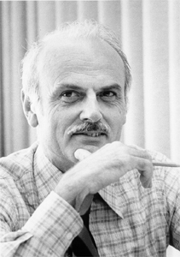

题外：数据库领域的四位图灵奖得主
Charles W. Bachman(查尔斯 • 巴赫曼) 1973
  主持设计与开发了最早的网状数据库管理系统
  IDS，它的设计思想和技术直接影响了后来的
  数据库。他还促成了数据库标准的制定，即
  DDL和DML规范说明。
Edgar F. Codd(埃德加 • 科德) 1981
  于1970年6月发表了题为“A Relational Model of
  Data for Large Shared Data Banks”一文，首次
  明确而清晰地为数据库系统提出了一种崭新的模
  型，即关系模型。一经提出迅速商品化。
James Gray(詹姆斯 • 格雷) 1998
  在事务处理技术上的创造性思维和开拓性工作，
  使他成为该技术领域公认的权威。在解决保障
  数据的完整性、安全性、并行性，以及从故障
  中恢复方面发挥了十分关键的作用。

Slide 38

题外：数据库领域的四位图灵奖得主
Michael Stonebraker(迈克尔 • 斯通布雷克) 2014
  对现代数据库系统底层的概念与实践所做出的基础性贡献。
  Michael Stonebraker在数据库领域以多产而著称，“发明了许多几乎所有现代数据库系统所用的概念，创办了无数成功的数据库技术公司”！
  他的影响跨越学术界和产业界，很难有在世者能与之媲美。而且此前他已经斩获美国工程院院士、IEEE软件系统奖、冯诺依曼奖和第一届SIGMOD Edgar F. Codd创新奖等多个重量级荣誉。
  1970s，开发了最早的关系型数据库Ingres（Sybase和SQL Server基于此发展而来）；
  1980s，开发了Postgres，增加对复杂数据类型的支持，后演变为PostgreSQL等；
  1990s，启动分布式数据库Mariposa；
  2000后，几乎每年都会开发一种新类型的数据库或数据处理系统，并创立一家公司。
大 神 ！

Slide 39
End of Chapter 1

